Slide 1
Gradient Coil Design

Slide 2
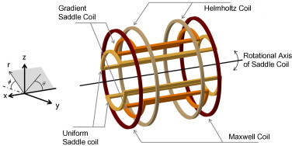
Geometry Overview

Slide 3
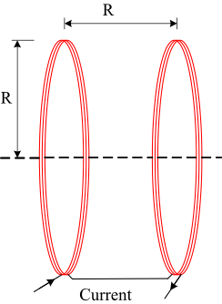
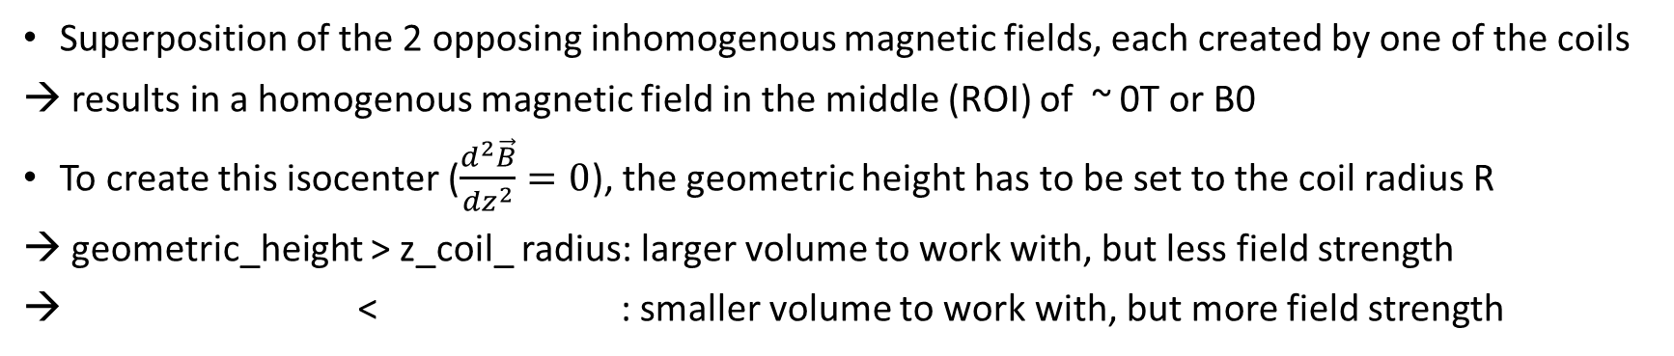
z-direction: Helmholtz coils
geometric_height =
z_coil_thickness
z_coil_radius =
z
Superposition of the 2 opposing inhomogenous magnetic fields, each created by one of the coils
results in a homogenous magnetic field in the middle (ROI) of ~ 0T or B0
To create this isocenter ($\frac{d^{2}\vec{B}}{dz^{2}}=0$), the geometric height has to be set to the coil radius R
geometric_height > z_coil_ radius: larger volume to work with, but less field strength
< : smaller volume to work with, but more field strength

Slide 4
z-direction: Helmholtz coils
Magnetic field in z-direction:
Desired field strength curve
B0
z
B_total
z
B0
isocenter

Slide 5
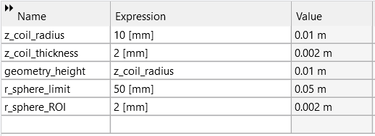
z-direction: Helmholtz coils
Initial values for the geometry:
Initial electromagnetic parameters:
Current : 1A
Number of Turns: 10

Slide 6
z-direction: Helmholtz coils
Optimization of #wires, current and coil thickness regarding the field strength and homogeneity:
→ simple grid search

Slide 7
x-direction: Saddlepoint Coils
Desired field strength curve for the spatial selection:
x/y
B_total
z

